Slide 1

Productions Possibilities Frontier (PPF)
1.1.1 The economic problem

Slide 2

Recap
The Basics

Slide 3

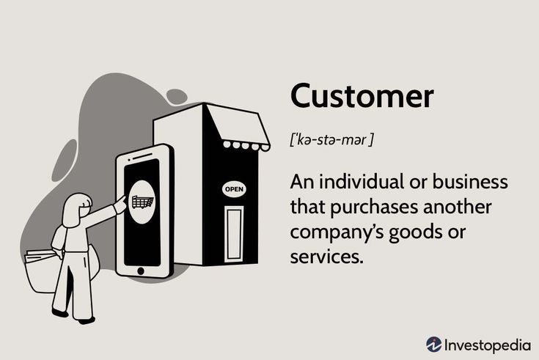

Economic agents
There are 3 key economic agents in an economy:
Businesses/producers
Consumers
Government
Let’s build a basic model of the economy between 3 economic agents. How do they interact with each other.
Where does it all begin?

Slide 4
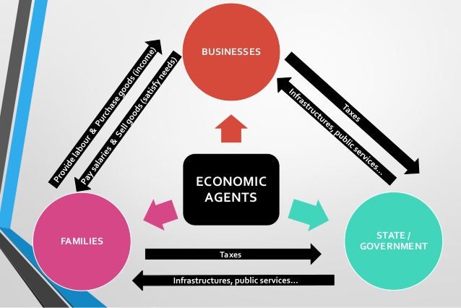
The interaction of economic agents

Slide 5
Economic agents as decision makers
All 3 agents make decisions, and when they make a decision, they have an opportunity cost.
YOU are a consumer and you make decisions 100s of times a day. What breakfast did you have? Cereal or Toast? The same happens when buying a good/service.
Let’s apply this decision making process to a model.

Slide 6
Time allocation - a decision on your 5 hours after school
Play | Work
0 | 5
1 | 4
2 | 3
3 | 2
4 | 1
5 | 0
How could we apply the above information to a graph?

Slide 7
The Production Possibilities Frontier
Play (hours)
5
4
3
2
1
Work (hours)
0
1
2
3
4
5

Slide 8

The Production Possibilities Frontier
This can be applied to an economy!
Deciding which products to produce for a whole economy can be illustrustrated using a production possibility frontier (PPF)
A PPF shows us the different combinations of two goods that can be produced if all factors of production (resources) in an economy are being used.
...so an assumption is when you use this model that only two goods can be produced.
Another assumption is that all resources are being fully used.

Slide 9
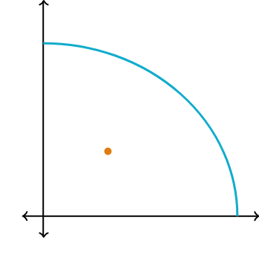
What does PPF show?
The PPC shows the maximum production of an economy based on its factors of production.
All goods and services produced can be placed into one of two categories:
Consumer goods - purchased by households (B2C), e.g. food
Capital goods - purchased by businesses to produce goods (B2B) e.g. machinery
Consumer goods
Capital goods

Slide 10
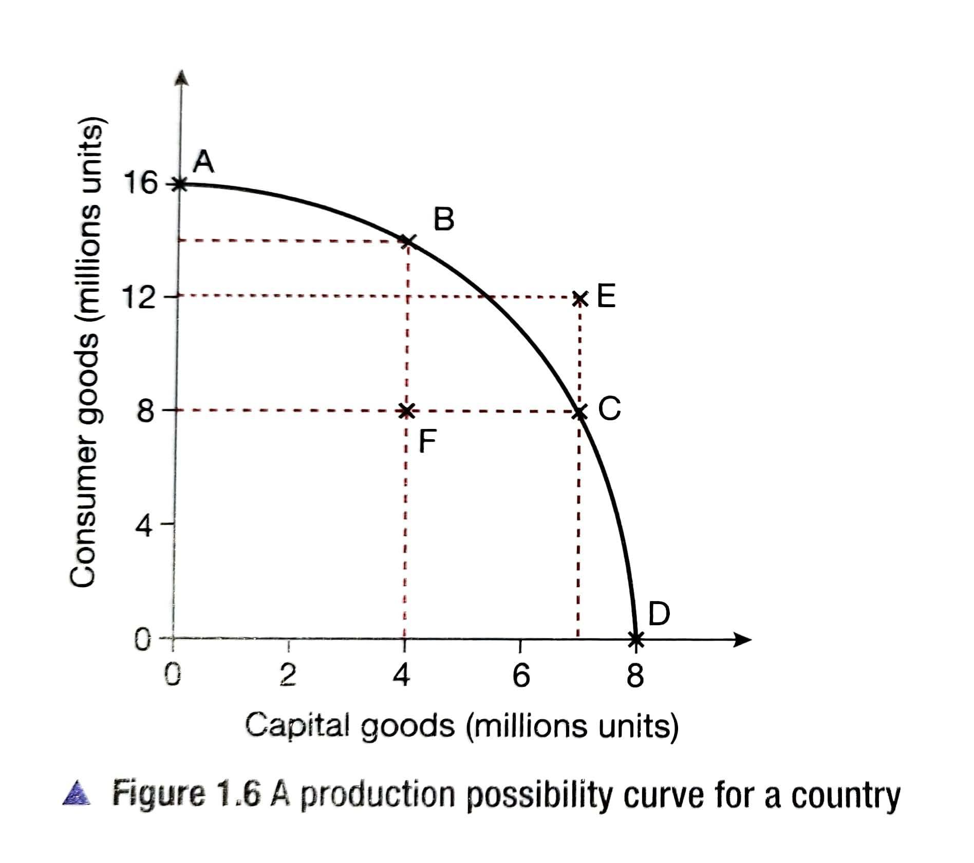
What does the PPF show? - Production levels
At point A, 16 million units of consumer goods are produced and 0 capital goods.
At point D?
At point B a combination of 14 million units of consumer goods and 4 million units of capital goods can be produced.
At point C?
At point F - 8 and 4 million but not all resources are being used. The point is INSIDE the PPC.
At points A, B, C and D resources are fully used. This is ideal.

Slide 11
What does the PPF show? - Opportunity cost
Now what if you move from B to C?
By moving ALONG the curve an opportunity cost is incurred.
To gain the additional 3 million units of capital goods, 6 million consumer goods are being lost.
The lost production of 6 million consumer goods is the opportunity cost.

Slide 12
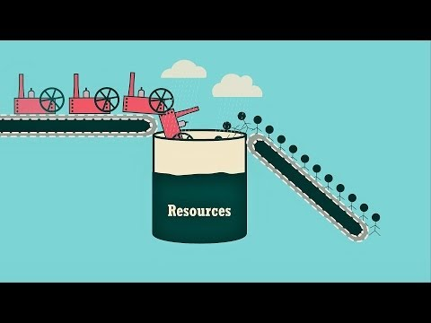
The PPF Review
Stop at 2:30
Notes:
https://www.youtube.com/watch?time_continue=89&v=PGaDeJ-oKzQ

Slide 13
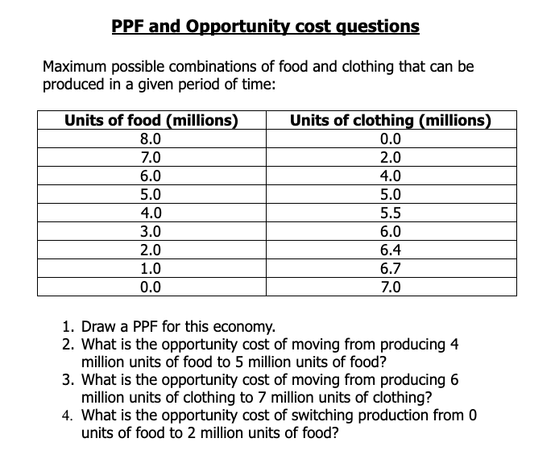
Your turn
Notes:
https://docs.google.com/document/d/108BWbjnCfEz0lDPiACPvlmykbKBThhV3fBHapkYbkqE/edit

Slide 14
Production Possibilities Frontier - Summary so far
Re-allocating scarce resources from one product to another involves an opportunity cost.
Deciding which goods to produce combined with the concept of opportunity costs can be illustrated using the PPC.
A PPC illustrates the different combination of goods that can be produced if all the resources in a country are fully used.
It shows the maximum quantities of goods that can be produced.

Slide 15
Challenge - what else can a PPF show?
What would happen to the curve in the following scenarios?
war breaking out in a country
a very dry summer
improved education
production of more capital goods
an economy operating at more than its potential
discovery of new technology.
Consumer goods
Capital goods

Slide 16
A PPF shift - Outward
An outward shift represents economic growth - an increase in a nation's output.
This can be caused by:
New technology
Improved efficiency
Education and training
New resources
Consumer goods
How do these lead to economy growth?
Capital goods

Slide 17
A PPF shift - Outward (Mix & Match)
Cause | Comment
Higher productivity / efficiency | This will drive extraction
Better management | Increase in workforce or capital investment
Increase in capital or labour | This increases the output per unit of input used in the production
Innovation and invention of new products and resources | Reduces waste and improves quality
Discovery / extraction of new natural resources (land) | Improved production processes will boost efficiency

Slide 18
A PPF shift - Outward (Answers)
Cause | Comment
Higher productivity / efficiency | This increases the output per unit of input used in the production
Better management | Reduces waste and improves quality
Increase in capital or labour | Increase in workforce or capital investment
Innovation and invention of new products and resources | Improved production processes will boost efficiency
Discovery / extraction of new natural resources (land) | This will drive extraction

Slide 19
Economic growth - Outward
Economic growth occurs when a country uses its resources more efficiently OR if more resources have been found - e.g. oil.
An improvement in the quality of factors of production
An increase in the quantity of factors of production
This is illustrated with the PPC shifting outwards.
Consumer goods
Capital goods

Slide 20
A PPF shift - Inward
Caused by any factor that significantly reduces the factors of production of a nation. What could cause a reduction in the factors of production?
Land
Labour
Capital
Enterprise
Consumer goods
Capital goods

Slide 21
A PPF shift - Inward
Examples of causes
Natural disasters e.g. drought, tsunami, earthquake, severe floods
Destruction / loss of factors of production because of civil war or other conflicts.
Large scales of labour migration if no prospect for jobs
Runs out of natural resources
Consumer goods
Capital goods

Slide 22
Challenge - what else can a PPF show?
In your books or notes, illustrate, using dynamic diagrams, the impact of the following 6 scenarios on the PPF.
war breaking out in a country
a very dry summer
improved education
production of more capital goods
an economy operating at more than its potential
discovery of new technology.
Consumer goods
Capital goods

Slide 23
Challenge - which will lead to greater growth?
Which point on the PPF will lead to greater growth? Why?
A
B will lead to greater growth as more capital goods means more investment by businesses. More investment will lead to improvements in the quality of the factors of production (capital goods) as well as the quantity of the factors of production.
Consumer goods
B
Capital goods

Slide 24
So what have you learnt? - Part 1 MCQs
Submit your answers to 12 multiple choice questions here. Discuss and share results and problem questions.

Slide 25
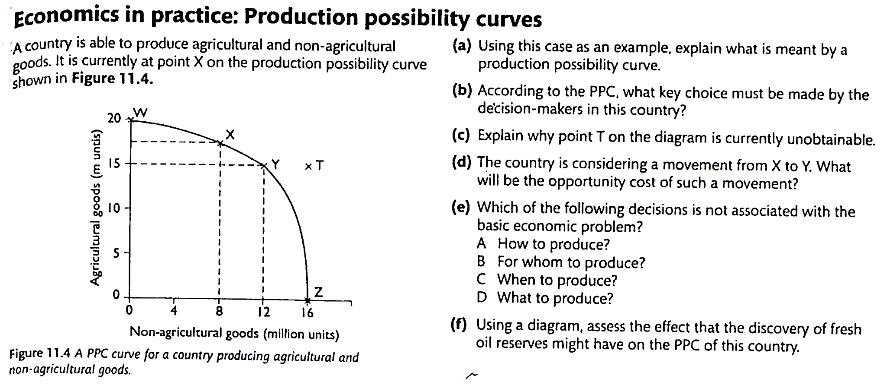
So what have you learnt? - Part 2

